Slide 1

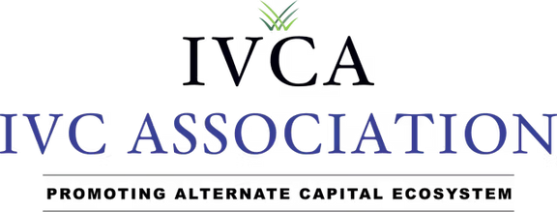

IVCA REGULATORY CIRCLES
CITY: Bengaluru
DATE: JUNE 17 | TIME: 4:30 PM – 9:00 PM

Slide 2



ADVOCACY
About
Multi-stakeholder approach with government and financial regulators for long term policy stability
IVCA
EDUCATE
Conduct high impact webinars, panel discussions, roundtable conferences on industry topics
1.
WE REPRESENT :
The interests of the entire Alternate Asset Industry, (active domestic AIF’s and global VCs, PEs, funds for Infrastructure, Real Estate, Credit funds, Limited Partners, Investment Companies, Family offices, Corporate VCs and Knowledge Partners)
RESEARCH
Handle data, research and publish industry reports & other publications
2.
WE REPRESENT :
Funds investing risk capital across stages and across the enterprise lifecycle: Seed to VC to Growth to pre-IPO or Buyout or Distress
NETWORK
Conduct high end networking for industry participants including LP-GP Meets, Deal flow discussions etc.

Slide 3


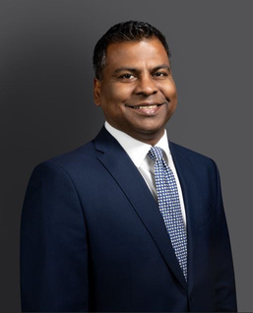
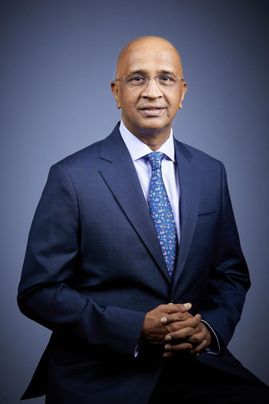
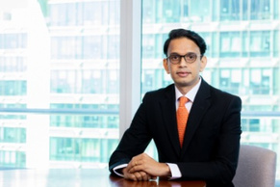
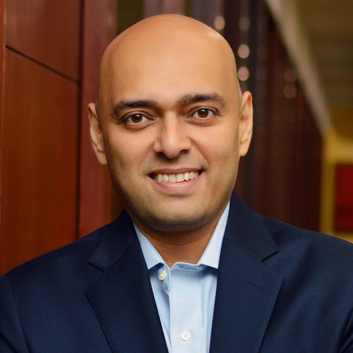
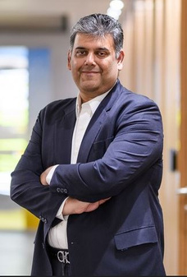
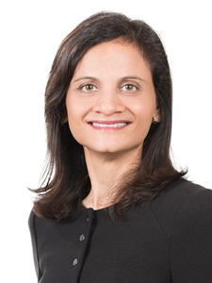
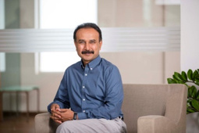
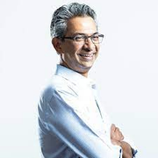
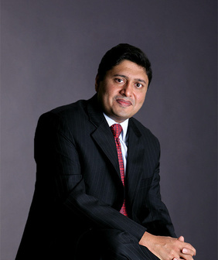
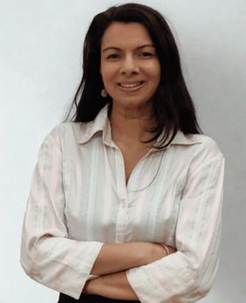
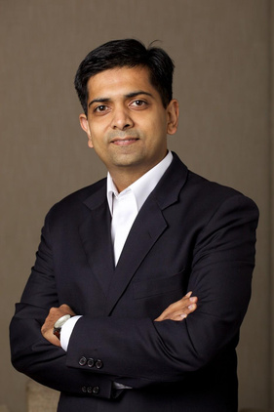
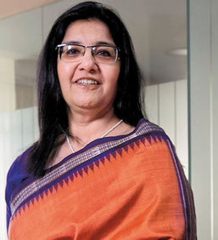
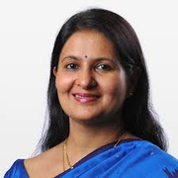
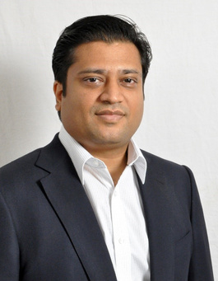
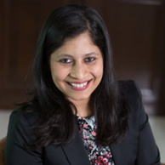

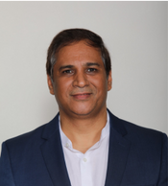
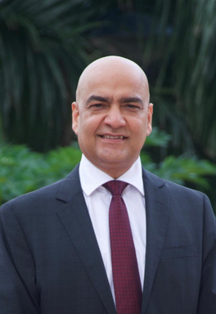
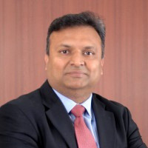
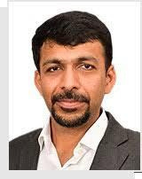
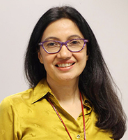
IVCA EXECUTIVE COMMITTEE, 2024-26
Ashley Menezes
Chairperson, IVCA & Partner & COO, ChrysCapital
Srini Sriniwasan
Vice-Chairperson, IVCA & Managing Director, Kotak Alternate Asset
Amit Jain
Managing Director, India Head, Carlyle India Advisors
Ashish Kotecha
Partner,
Bain Capital
Karan Bhagat
Founder, MD & CEO,
360 ONE
Kanchan Jain
Head of BPEA Credit Group,
BPEA Credit
Prashanth Prakash
Founding Partner,
Accel Partners India LLP
Rajan Anandan
Managing Director, Peak XV
Manish Kejriwal
Founder & Managing Partner,
Kedaara Capital
Lavanya Ashok
General Partner,
Growth Equity,
Trifecta Capital
Narendra Ostawal
Managing Director, Head of India Private Equity, Warburg Pincus
Padmaja Ruparel
Co Founder,
Indian Angel Network (IAN)
Ashu Suyash
Founder and CEO,
Colossa Ventures
Gopal Jain
Managing Partner &
CO-Founder,
Gaja Capital
Rochelle D’Souza
Managing Director,
Lighthouse Funds
Siddarth Pai
Founding Partner,
3one4 Capital
SPECIAL INVITEES
Vipul Roongta
Managing Director & CEO,
HDFC Capital Advisors
Vineet Rai
Founder, Aavishkaar Group
Vikram Gupta
Founder, IvyCap Ventures
Saurabh Jain
Business/ Functional
Head, NIIF
Nivruti Rai
Invest India MD & CEO

Slide 4

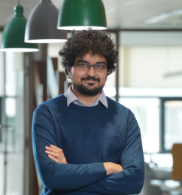



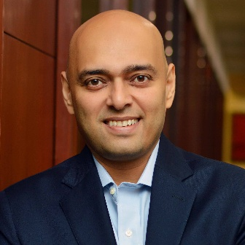
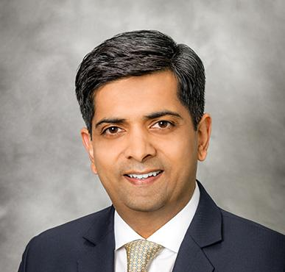

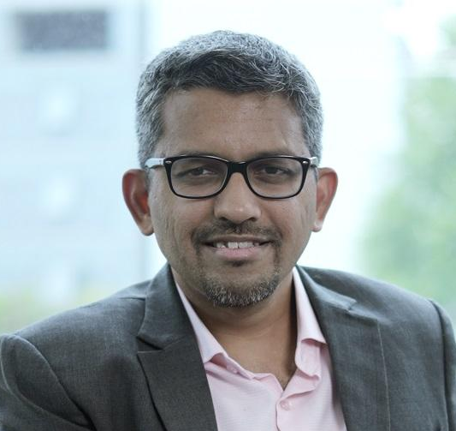

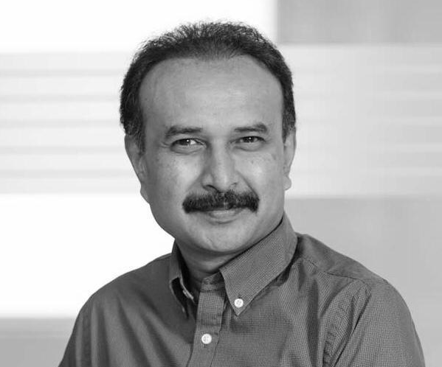
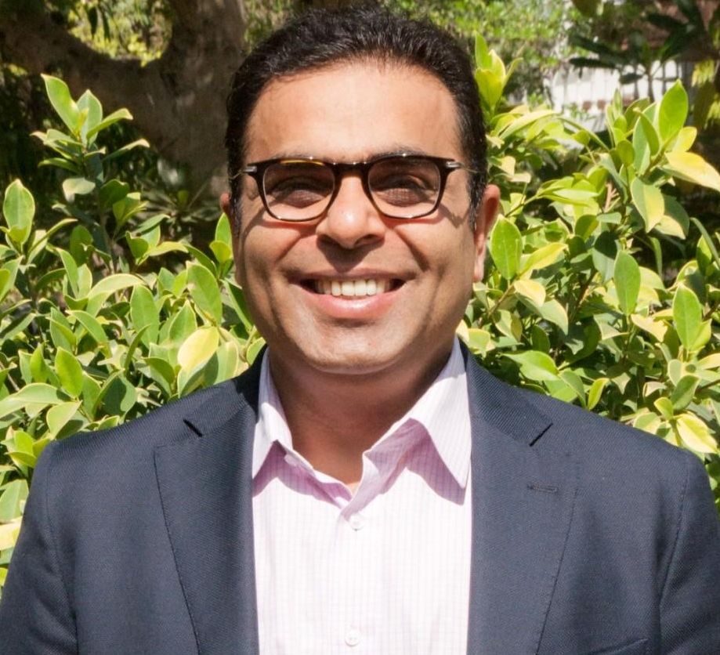
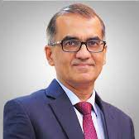
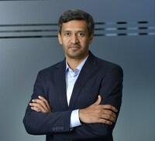
IVCA SECTOR COUNCILS & COMMITTEES (1/2)
REGULATORY AFFAIRS COMMITTEE
PRIVATE EQUITY COUNCIL
Siddarth Pai, Founding Partner,
3one4 Capital
Gopal Jain Managing Partner & CO-Founder,
Gaja Capital
Manish Kejriwal,
Founder & Managing Partner, Kedaara Capital
Karan Bhagat
Founder, MD & CEO, 360 ONE
GLOBAL INVESTORS COUNCIL
CREDIT & SPECIAL SITUATIONS COUNCIL
Ashish Kotecha,
Partner, Asia Pacific Private Equity Team, Bain Capital
Kanchan Jain,
Head, Ascertis Credit Group
Vineet Sukumar,
Co-Founder & Managing Director, Vivriti Capital
Narendra Ostawal,
Managing Director,
Warburg Pincus
VC COUNCIL
CAT III COUNCIL
Vikaas M Sachdeva, Managing Director, Sundaram Alternates
Bhautik Ambani,
Chief Executive Officer, AlphaGrep Investment Management
Rajan Anandan, Managing Director,
Surge & Peak XV Partners
Prashanth Prakash,
Founding Partner, Accell
Manish Kheterpal,
Co-Founder & Partner, Waterbridge Ventures

Slide 5

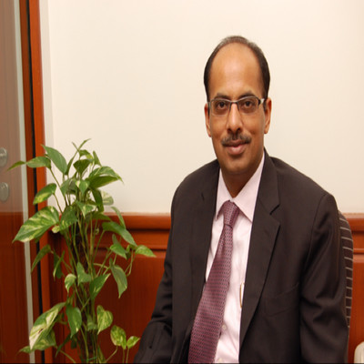

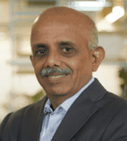
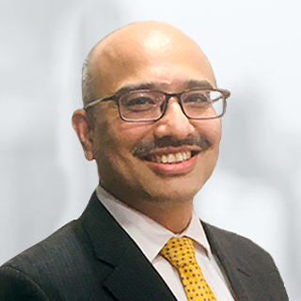
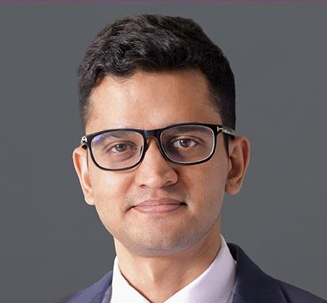
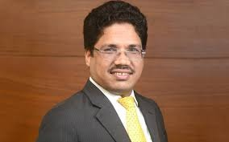
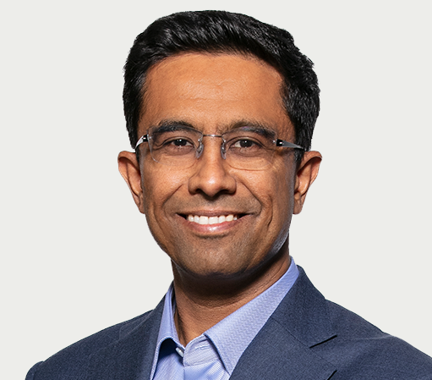
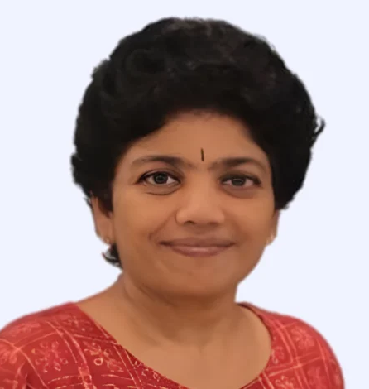
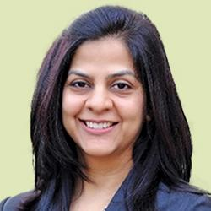
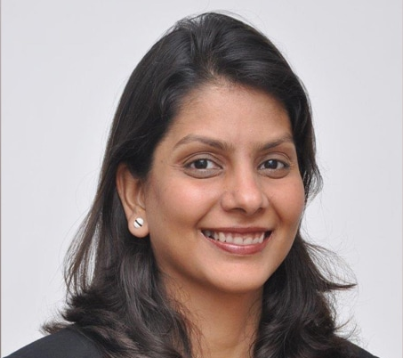
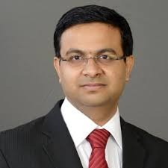
IVCA SECTOR COUNCILS & COMMITTEES (2/2)
REAL ESTATE COUNCIL
IMPACT & COUNCIL
Vipul Roongta,
Managing Director & CEO,
HDFC Capital Advisors
Amit Bhagat, CEO & Managing Director, ASK Investment Advisors
TCM Sundaram,
Founder and Vice Chairman, Chiratae Ventures
Sowmya Suryanarayanan,
Head - Impact and ESG, Aavishkaar Capital
INFRASTRUCTURE COUNCIL
LIMITED PARTNERS COUNCIL
Parag Baduni
Partner, National Investment and Infrastructure Fund (NIIF)
Arpit Aggarwal, Managing Partner, Brookfield Asset Management
Subahoo Chordia, President and Head Real Assets, EAAA Alternatives
Kunal Sood, Managing Director, Pantheon Ventures
DIVERSITY, EQUITY, INCLUSIVITY COUNCIL
CLIMATE & SUSTAINABILITY COUNCIL
Pratibha Jain, Group General Counsel and Head of Strategy, Everstone Group
Anuradha Ramachandran, Managing Partner, TVS Fund
Nupur Garg, President, WinPe
Akhilesh Tilotia,
Co-founder, Thurro

Slide 6
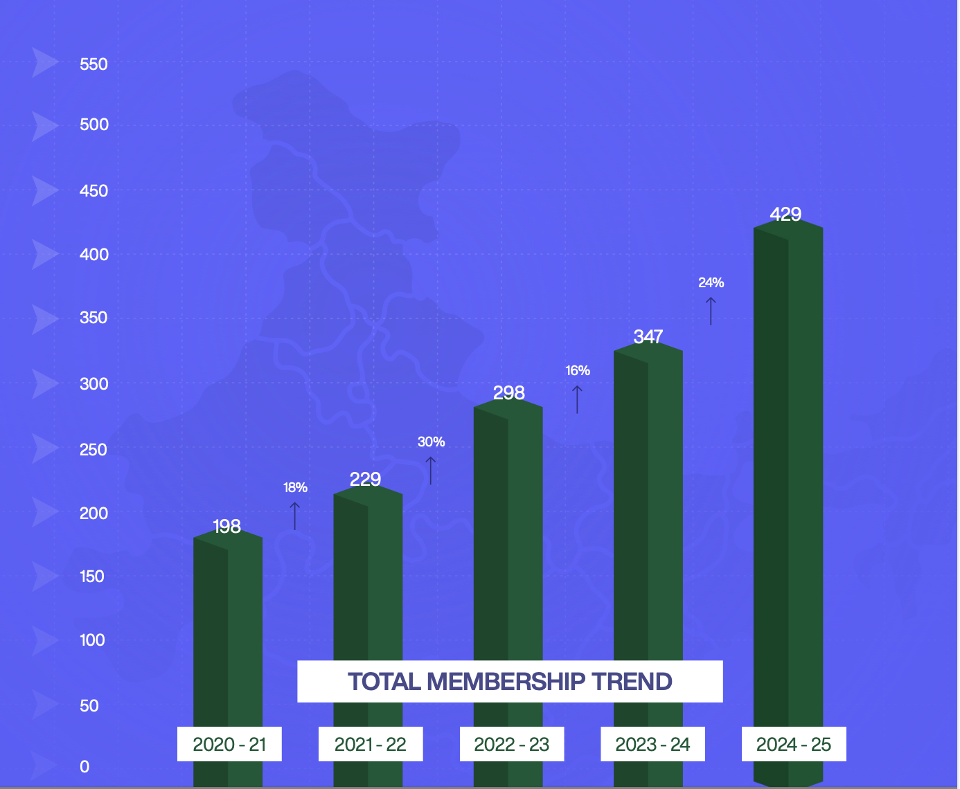
IVCA ALTERNATE CAPITAL REPRESENTATION (1/2)
Represents a network of 400+ fund managers, comprising ~30% of the estimated 1,200 fund managers investing in India.
IVCA members manage over $350 billion in assets across venture capital, private equity, credit, and other alternate capital strategies.
The broader pool of 1,200 managers includes several entities with limited activity, having made only 1–2 investments over time.

Slide 7
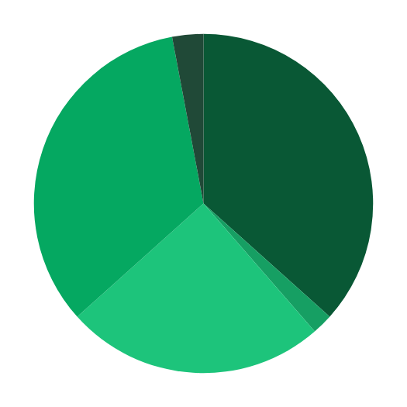
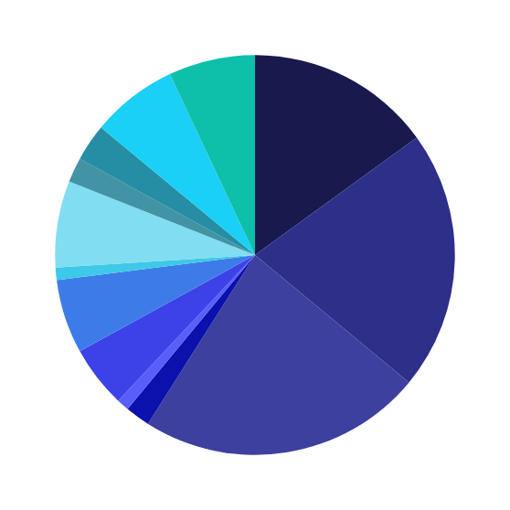
IVCA ALTERNATE CAPITAL REPRESENTATION (2/2)
Growth, Late,
3%
AM,
7%
CAT III,
7%
PE, 15%
IVCA MEMBER DOMICILE
Family Office,
3%
Early, 37%
LP,
2%
Type
% Share
Multi Asset,
7%
VC, 21%
Early, Growth, Late, 34%
Domestic
77%
Infra,
1%
(Headquarters in India)
RE,
6%
Foreign
23%
Credit,
5%
(Headquarters outside of India)
Growth, 2%
Venture Dept, 1%
Early, Growth, 25%
Corporate VC, 2%
Micro VC, 23%
VC Members’ Investment Strategy
Membership Distribution by Fund Type

Slide 8
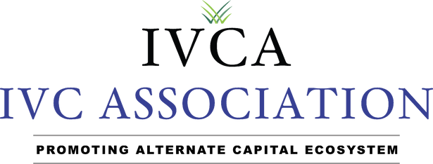
IVCA REGULATORY AFFAIRS COUNCIL
Co - Chair
IVCA Advocacy Team
Gopal Jain
Siddarth Pai
Rahul Shah
Partner & CO-Founder,
Gaja Capital
Founding Partner,
3one4 Capital
Executive Vice President,
IVCA
Dipen Ruparelia
Dr. Pritesh Majmudar
Harish Agarwal
Kalpesh Jain
Rohan Parulekar
Head of Products, Vivriti Asset Management
Head - Legal & Compliance, DSP Asset Managers Pvt Ltd
President & Chief Operating Officer, Edelweiss Alternative Asset Advisors
MD & CFO,
Multiples Alternate Asset Management
Senior Vice President, IVCA
Pratibha Jain
Prashanth Prakash
Rajeev Saptarshi
Saurabh Jain
Soniya Tolani
Head of Strategy & Group General Counsel
Founding Partner,
Accel Partners India LLP
Chief Operating Officer, Kotak Investment Advisors
Chief Operating and Chief Financial officer
Senior Manager, IVCA
Vikaas Gupta
Vaibhav Goel
Vardaan Ahluwalia
Prajwal
Sr Vice President, at West bridge Capital
Partner & CFO at Elevation Capital
General Counsel, Premji Invest
Senior Associate, IVCA
https://www.ivca.in/committee/council?tab=regulatory-affairs

Slide 9
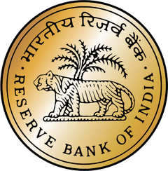









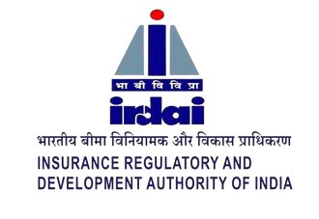







WHO DO WE WORK WITH FOR POLICY ADVOCACY
MoU’s with CII, FICCI, IFSCA, BIRAC & USISPF, SPF – United voice of advocacy for Industry

Slide 10

ADVOCACY PROCESS
Stakeholder meetings are conducted to highlight the adverse industry impact of the issue, with support from IVCA’s Councils, SIGs, Members, and Knowledge Partners.
Members communicate the
issues to the IVCA Advocacy Team via
regulatoryaffairs@ ivca.in
The IVCA Advocacy Team takes inputs
from the respective
Sector Council and/or Special Interest Group
The IVCA Advocacy Team then takes the opinion of the Regulatory
Affairs Council basis the
severity of the issue being an
Industry wide issue
Creation of
white paper for
representation and
identification of regulatory stakeholders for subsequent submissions
and meetings
Updates
added to the Doc send repository and same shared via newsletter, Capital call, WA group and webinars
As part of wider communication with members of IVCA, ”we have created a Doc send link which is a repository of representations IVCA has made over the last few years to the government bodies.”
Here is the link for repository of submissions for your kind reference. : https://docsend.com/view/s/rhuijikq799nwt6x

Slide 11

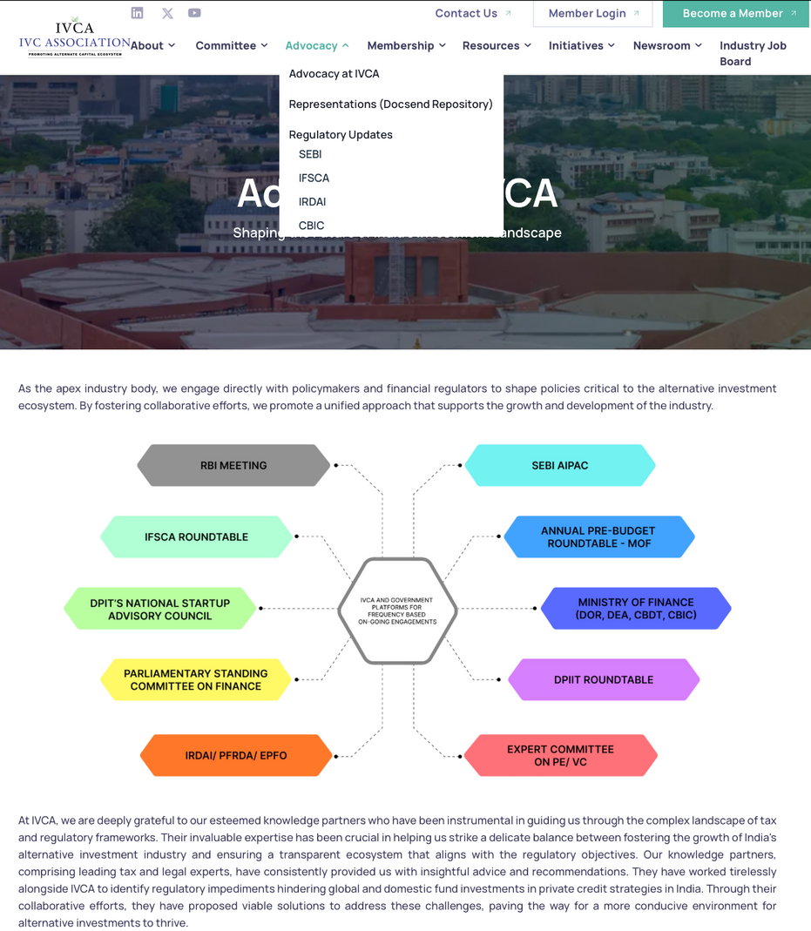

ADVOCACY WEBPAGE
As part of wider communication with members of IVCA, we have a dedicated webpage on the IVCA website.
Important updates specific to regulators are shared
Member exclusive content is in the Doc send link which is a repository of representations IVCA has made over the last few years to the government bodies:
https://docsend.com/view/s/rhuijikq799nwt6x

Slide 12
GOVERNMENT & REGULATORY WINS
Key Policy Milestones
FY’ 26 (current)
FY’ 25
FY’ 24
Taxation Pass Through for CAT I and CAT II Funds
Parity of Taxation for Investments in Unlisted vs Listed Securities
Abolishment of Angel tax
Classification of AIF securities as capital assets.
Formation of the Fund of Funds for Startups (FFS) Program, including recent addition of INR 10k
Setup of the Damodaran Committee for PE/VC Funds
Investment Guidelines from PFRDA, IRDAI and RBI for Capital allocation to AIFs
Issuance of AIF Regulations for setting up funds in IFSC
Formation of the Unified Regulator at IFSCA in the form of IFSCA
16 Meetings
11 Representations
7 Wins
63 Meetings
113 Representations
18 Wins
60 Meetings
98 Representations
8 Wins
SEBI
RBI
Flexibility under Accredited Investor Framework.
Flexibility for AIFs to deal with Unliquidated Investments
Dissolution Period instead of launching a new liquidation scheme
VCFs to migrate to AIF Regulations into AIF Category 1 Migrated VCFs, and extension of timeline for liquidation.
Relaxation in timelines for holding AIFs investments in dematerialized form
Extension of timeline NISM certification to July 31, 2025
NISM - Splitting of Modules into Series-XIX-D, Series-XIX-E
Option of CPE for Renewal
RBI to adopt an appropriate and liberal view on compounding cases involving PPUs issued before March 2024.
Self-certifying REs with fewer than 100 clients are now exempted from the mandatory Market-SOC requirement.
⁠Investments by an AIF in equity-linked securities such as CCPS and CCD, are permitted, without any provisioning*
RE’s contribution to any AIF Scheme shall be capped at 10% of its corpus. Collectively, a ceiling of 15% shall apply for investments by all REs in an AIF Scheme*

Slide 13



















SUPPORTING PARTNERS

Slide 14




REGULATORY CIRCLES
01
02
03
Why IVCA Regulatory Circles
Purpose of Regulatory Circles
Objectives of the Regulatory Circles
For Evolving Regulations.
For Compliance/Challenges.
For Collaboration.
For Policy Clarity.
Discuss pain points in compliance and reporting.
Strengthen industry collaboration and consistency.
Channel real-time, finance-driven insights into IVCA’s policy advocacy agenda.
Inclusive Community Building.
Regular Engagement.
Consensus on Operationalizing Regulations.
Knowledge Sessions & Capacity Building.
Linkage with IVCA Regulatory Affairs Committee.
Policy Updates.
A Single-Point Solution.
Notes:
Formatting

Slide 15


CALL TO ACTION
01
02
Community Contribution
Call to Action: Join, Engage, Influence
🤝 Share Stakeholder Lists (CFOs/Compliance Head)
🌟 Form a core Voluntary Group
🧩 Top regulatory concerns and suggestions for standardization and capacity building
✅ Participate Actively – Be part of regular discussions and knowledge exchange
🤝 Volunteer – Contribute to shaping the regulatory dialogue
📢 Stay Informed – Receive timely policy updates and developments
*Join the Circle. Influence the Future Co-create a regulatory environment that is pragmatic, future-ready, and growth-focused. Your voice matters in shaping the path ahead.
Notes:
Formatting

Slide 16
PATH FORWARD
Review of Income Tax Bill 2025 (Pre- Budget Tax Document)
Unlocking Domestic Pools of Capital- Insurance/ Pension Funds/EPFO/ Banks
LLP Structure for AIFs
Revamping AIF Regulations 2012
1
3
4
7
Taxation of Carried Interest, GST Notices
Accredited Investor Framework, Demat Timelines
2
5
Operationalization of New Fund Structures (VCC, FOF, Deep Tech FOF, SWAMIH Fund)
6

Slide 17
ONGOING KEY ENGAGEMENTS – DEPARTMENT WISE
CBDT (PRE-BUDGET DOC)(1/5)
Review of New Income Tax Bill 2025
CAT III AIF Taxation - Determination of Trust Status
Taxation parity for AIFs vs Debt MFs, Hybrid MFs
Extinguishment of the Units during liquidation of an Investment Fund 2(47)
Allowing Charitable Trusts / Endowment Funds to investment in AIFs (17C)
Investment by an AIF in SRs and investment by a Special Situation Fund in Stressed Loans
Outbound Fund tax regime in IFSC
Change in the determination of fair market value to include equity-linked securities, such as CCPS. Rule 11UA (1)(b)

Slide 18
ONGOING KEY ENGAGEMENTS – DEPARTMENT WISE (2/5)
DEA
CBIC
Inter-Regulatory Working Group Committee: RBI, IRDA, PFRDA, etc., and industry participants.
LLP Structure for AIFs
RBI Regulated Entities investments in AIFs
Classification of AIFs as “Regulated Deposit Scheme” under BUDA & BULA Act.
Safe Harbour provisions (Section 9A) for Global funds
India-Japan DTAA – Addressing Challenges for Japanese VC Firms Investing in India
Taxation of Carried Interest
Issuance of GST Notices to AlFs
*(IVCA has updated GST template on website to guide members in responding to notices)

Slide 19
ONGOING KEY ENGAGEMENTS – DEPARTMENT WISE (3/5)
DOR (REVENUE SECRETARY)
DFS/RBI
Overseas Direct Investments Limits
Excluding AIFs from the BUDA & BULA Act
Removing restrictions on banks and NBFCs investing in AIF LLPs
SARFAESI Issues (DFS)
Review of New Income Tax Bill 2025
Taxation parity for AIFs and Debt MFs, Hybrid MFs

Slide 20
ONGOING KEY ENGAGEMENTS – DEPARTMENT WISE (4/5)
NSIC/ MSME
CCI
Minority Acquisition Exemption
Deal Value Threshold Test
Inclusion of Private Credit/Debt funds as daughter funds for the SRI Fund (“Mother Fund”)
DPIIT
MCA
LLP as a Viable Structure for AIFs
Press Note 3
FPI Disclosure Norms
Alignment of FEMA and Company Law

Slide 21
ONGOING KEY ENGAGEMENTS – DEPARTMENT WISE (5/5)
SEBI
SFA
Implementation Standards –
For Differential Rights of Investors
For Due Diligence of Investors and Investments
For Borrowing in AIFs Investing in the Infra Sector
Matters to not Constitute PPM Amendments
AIF Demat Extension: Proposal for Handling Non-Compliant Investors via Escrow Mechanism and Implementation Guidelines
Flexibility for VCFs registered under the erstwhile SEBI (VCF) Regulations, 1996
Note on Material Adverse Effects for Exclusion
Creation of the Custodian Data Reporting Template
Revamping AIF Regulation
Valuation Issues
Cybersecurity Framework
NISM Certification for Fund Managers – Grandfathering Experience
Category III (CAT III) Funds-
Increasing the Leveraging
Sub-categorisation of CAT III
Simplifying Accredited Investor Framework
Clarification on Pro-Rata Distribution

Slide 22

Details of CFO / Head Legal and Compliance

Slide 23
Thank You

